Slide 1
Chapter 18: The Pentium and Pentium Pro Microprocessors

Slide 2
Introduction
The Pentium microprocessor signals an improvement to the architecture found in the 80486 microprocessor.
These changes are internal to the Pentium, which makes software upward-compatible from earlier Intel 80X86 microprocessors.
A later improvement to the Pentium was the addition of the MMX instructions.

Slide 3
Chapter Objectives
Upon completion of this chapter, you will be able to:
Contrast the Pentium and Pentium Pro with the 80386 and 80486 microprocessors.
Describe the organization and interface of the 64-bit-wide Pentium memory system and its variations.
Contrast the changes in the memory-management unit and paging unit when compared to the 80386 and 80486 microprocessors.

Slide 4
Chapter Objectives
(cont.)
Upon completion of this chapter, you will be able to:
Detail the new instructions found with the Pentium microprocessor.
Explain how the superscalar dual integer units improve performance of the Pentium microprocessor.
Describe the operation of the branch prediction logic.

Slide 5
Chapter Objectives
(cont.)
Upon completion of this chapter, you will be able to:
Detail the improvements in the Pentium Pro when compared with the Pentium.
Explain how the dynamic execution architecture of the Pentium Pro functions.

Slide 6
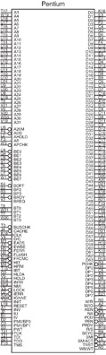
18–1 INTRO TO THE PENTIUM PROCESSOR
the pin-out of the Pentium processor, packaged in a huge 237-pin PGA (pin grid array)
Pentium is available in two versions:
the full-blown Pentium
P24T version called the Pentium OverDrive
P24T version contains a 32-bit data bus, for insertion into 80486 machines which contain the P24T socket
Figure 18–1 The pin-out of the Pentium microprocessor.

Slide 7
Each Pentium output pin is capable of providing 4.0 mA of current at logic 0 level and 2.0 mA at logic 1 level.
compared to the 2.0 mA available 8086-80286
Each input pin represents a small load requiring only 15 µA of current.
In some systems, except the smallest, these current levels require bus buffers.

Slide 8
The Memory System
Memory system for the Pentium is 4G bytes.
just as in 80386DX and 80486 processors
Pentium uses a 64-bit data bus to address memory in eight 512M byte banks.
Memory is divided into eight banks with each bank storing byte-wide data with a parity bit.
The Pentium, like 80486, employs internal parity generation and checking logic for the memory system’s data bus information.

Slide 9
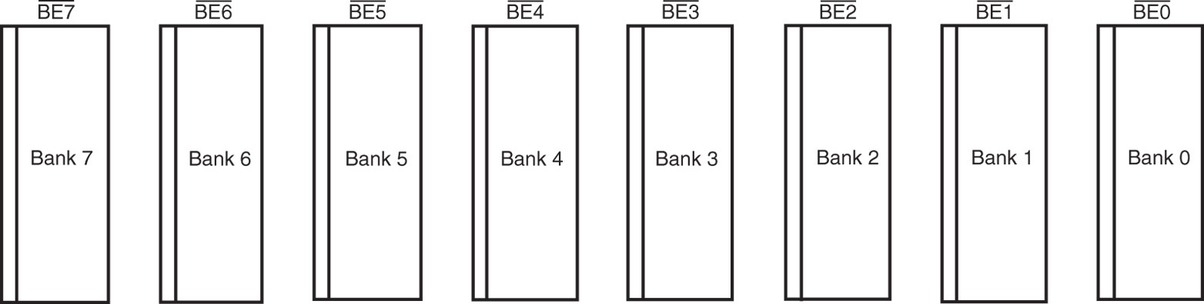
Figure 18–2 The 8-byte-wide memory banks of the Pentium microprocessor.
Pentium systems do not use parity checks, because ECC is available
64-bit-wide memory is important to double-precision floating-point data
Pentium is able to retrieve floating-point data with one read cycle, instead of two as in 80486

Slide 10
The memory system is numbered in bytes, from byte 00000000H to byte FFFFFFFFH.
Memory selection is accomplished with bank enable signals (BE7-BE0).
The banks allow Pentium to access any single byte, word, doubleword, or quadword with one memory transfer cycle.
A new feature is ability to check and generate parity for the address bus (A₃₁–A₅).

Slide 11
The AP pin provides the system with parity information and the APCHK indicates a bad parity check for the address bus.
Pentium takes no action when an address parity error is detected.
The error must be assessed by the system and the system must take appropriate action.
an interrupt, if so desired

Slide 12
Input/Output System
Input/output system of Pentium is completely compatible with earlier Intel processors.
I/O port number appears on lines A₁₅–A₃
Bank enable signals select actual memory banks used for the I/O transfer.
I/O privilege information is added to the TSS segment when Pentium is in protected mode.
If blocked I/O is accessed, Pentium generates a type 13 interrupt, I/O privilege violation.

Slide 13
System Timing
Pentium nonpipelined memory cycle consists of two clocking periods: T₁ and T₂.
Figure 18–3 shows basic nonpipelined read
66 MHz Pentium is capable of 33 million memory transfers per second.
assuming memory can operate at that speed
W/R becomes valid if ADS is logic 0 at the positive edge of the clock (end of T₁).
clock must qualify cycle as read or write

Slide 14
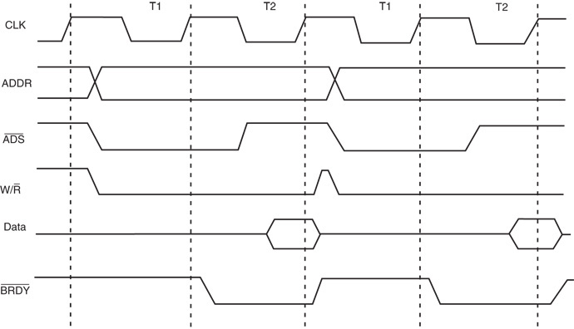
Figure 18–3 The nonpipelined read cycle for the Pentium microprocessor.

Slide 15
During T₁, the processor issues the ADS, W/R address, and M/IO signals.
In order to qualify W/R & generate appropriate MRDC and MWTC signals, we use a flip-flop to generate the W/R signal.
A two-line-to-one-line multiplexer then generates memory and I/O control signals.
See Fig 18–4 for a circuit that generates I/O control and memory signals for Pentium.

Slide 16
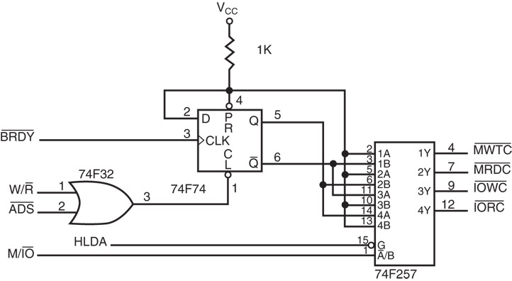
Figure 18–4 A circuit that generates the memory and I/O control signals.

Slide 17
During T₂, the data bus is sampled in synchronization with the end of T₂ at the positive transition of the clock pulse.
Setup time before the clock is given as 3.8 ns.
Hold time after the clock is given as 2.0 ns.
the data window around the clock is 5.8 ns
The address appears on the 8.0 ns maximum after the start of T₁.

Slide 18
Pentium at 66 MHz allows 30.3 ns (two clocking periods), minus the address delay of 8.0 ns and minus data setup of 3.8 ns.
Memory access time without any wait states is 30.3 – 8.0 – 3.8, or 18.5 ns.
This is enough to allow access to SRAM.
not DRAM without inserting wait states
SRAM is normally found in the form of an external level 2 cache.

Slide 19
Wait states are inserted by controlling the BRDY input to the Pentium.
BRDY must become logic 0 by the end of T₂
or additional T₂ states are inserted in the timing
Inserting wait states lengthens timing to allow additional time for the memory to access data.
In the timing shown, access time has been lengthened so 60 ns DRAM can be used.
requires insertion of four wait states of 15.2 ns (one clocking period) each to lengthen access time to 79.5 ns

Slide 20
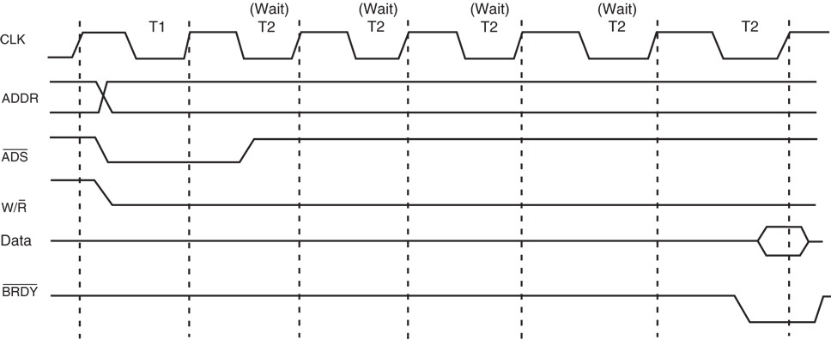
Figure 18–5 The Pentium timing diagram with four wait states inserted for an access time of 79.5 ns.
a read cycle timing diagram that contains wait states for slower memory.

Slide 21
BRDY is a synchronous signal generated by using the system clock.
Figure 18–6 illustrates a circuit to generate BRDY for inserting any number of wait states into the Pentium timing diagram.
The ADS signal is delayed between 0 and 7 clocking periods by the 74Fl61 shift register to generate the BRDY signal.
The exact number of wait states is selected by the 74F151 eight-line-to-one-line multiplexer.

Slide 22
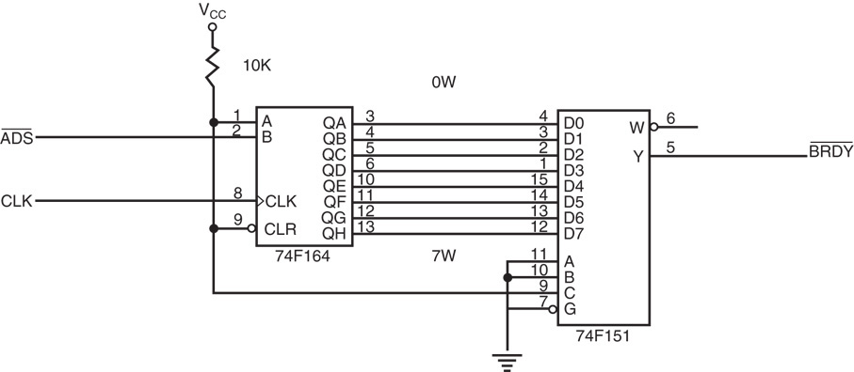
Figure 18–6 A circuit that generates wait states by delaying ADS. This circuit is wired to generate four wait states.

Slide 23
The burst cycle is a more efficient method of reading memory data.
burst cycle in Pentium transfers four 64-bit numbers per cycle in five clocking periods
A burst without wait states requires the memory system transfer data every 15.2 ns.
With a level 2 cache, this speed is no problem as long as the data are read from the cache.
If the cache does not contain the data, wait states must be inserted, reducing throughput.

Slide 24
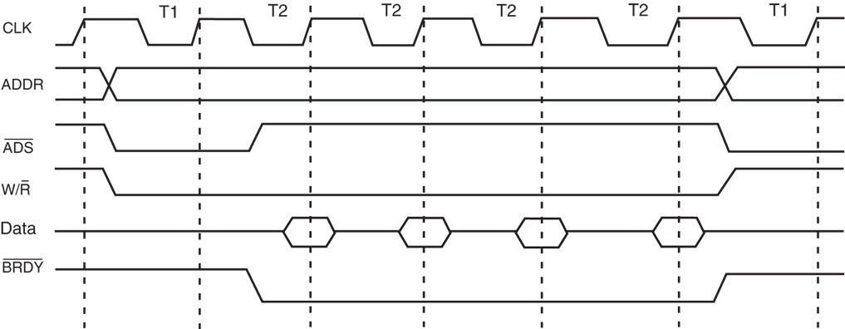
Figure 18–7 The Pentium burst cycle operation that transfers four 64-bit data between the microprocessor and memory.
wait states can be inserted to allow more time to the memory system for accesses

Slide 25
Branch Prediction Logic
Used by Pentium to reduce time required for a branch caused by internal delays.
Delays are minimized when a branch is encountered, because the processor begins prefetch instruction at the branch address.
If the branch prediction logic errs, the branch requires an extra three clocking periods to execute.
in most cases, branch prediction is correct and no delay ensues

Slide 26
Cache Structure
Pentium contains two 8K-byte cache memories instead of one as in 80486.
one 8K-byte instruction cache stores only instructions
another 8K-byte cache stores data used by instructions
In the 80486 unified cache, a data-intensive program quickly filled the cache, and slowed execution speed.
this cannot occur in Pentium separate caches

Slide 27
Superscalar Architecture
Pentium has three execution units.
One executes floating-point instructions
the other two (U-pipe and V-pipe) execute integer instructions
This means it is possible to execute three instructions simultaneously.
because the floating-point unit is also used for MMX instructions, Pentium can simultaneously execute two integers and one MMX instruction.

Slide 28
18–2 SPECIAL PENTIUM REGISTERS
Pentium is essentially the same as 80386 and 80486
except some additional features and changes to the control register set have occurred
This section highlights the differences between the 80386 control register structure and the flag register.

Slide 29
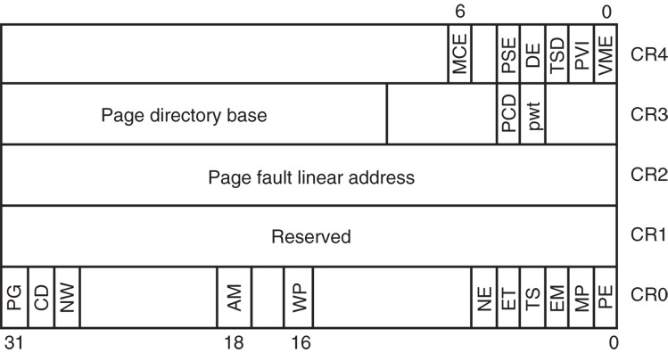
Figure 18–8 The structure of the Pentium control registers.
Control Registers
a new control register, CR₄, has been added to the control register array

Slide 30

Figure 18–9 The structure of the Pentium EFLAG register.
EFLAG Register
the extended flag (EFLAG) register has been changed in the Pentium
four new flag bits have been added to control or indicate conditions about some of the new features in the Pentium

Slide 31
Built-In Self-Test (BIST)
Accessed on power-up by placing logic 1 on INIT while the RESET changes from 1 to 0.
BIST tests 70% of the internal structure of the Pentium in approximately 150 µs.
Upon completion, Pentium reports outcome in register EAX.
If EAX = 0, BIST has passed and Pentium is ready for operation.
if EAX contains any other value, the Pentium has malfunctioned and is faulty

Slide 32
18–3 PENTIUM MEMORY MANAGEMENT
The memory-management unit within the Pentium is upward-compatible with 80386 and 80486 processors.
Many features of these earlier processors are basically unchanged in the Pentium.
The main change is in the paging unit and a new system memory-management mode.

Slide 33
Paging Unit
Paging table structure can become large in a system with a large memory.
to fully repage 4G memory, requires over 4M bytes of memory for the page tables
Paging functions with a new Pentium extension with 4M-byte memory pages.
the new feature reduces the structure to a single page directory, with no page tables
The new 4M-byte page sizes are selected by the PSE bit in control register 0.

Slide 34
In the 4M paging scheme there is no page table entry in the linear address.
See Figure 18–10 for the 4M paging system in the Pentium processor.
The leftmost 10 bits of the linear address select an entry in the page directory.
just as with 4K pages
Unlike 4K pages, there are no page tables.
the page directory addresses a 4M-byte page

Slide 35
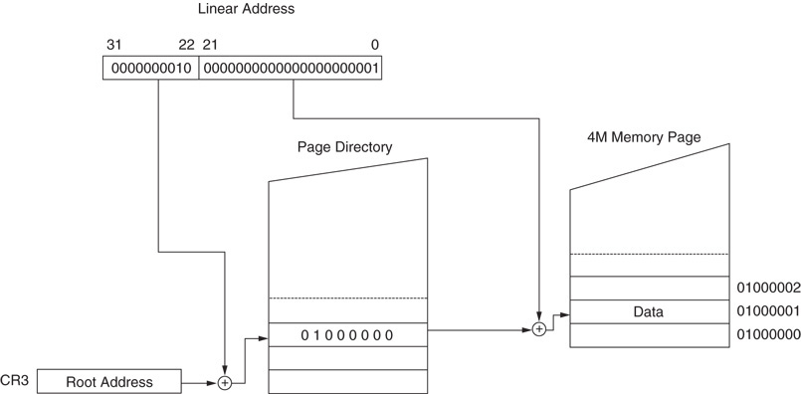
Figure 18–10 The linear address 00200001H repaged to memory location 01000002H in 4M-byte pages. Note that there are no page tables.

Slide 36
Memory-Management Mode
System memory-management mode (SMM) is on the same level as protected, real, and virtual modes,
but it is provided to function as a manager
It is intended for high-level system functions such as power management and security.
Access to the SMM is accomplished via a new external hardware interrupt applied to the SMI pin on the Pentium.

Slide 37
When the SMM interrupt is activated, the processor begins executing system-level software in an area of memory called the system management RAM, or SMMRAM
called the SMM state dump record
SMI disables all other normal interrupts
Return from memory-management mode interrupt to the interrupted program, at the point of the interruption, is done with a new instruction called RSM.

Slide 38
SMM mode allows the Pentium to treat the memory system as a flat, 4G-byte system.
SMM interrupt also stores the state of the Pentium in a dump record.
allows a system to enter a sleep mode and reactivate at the point of program interruption
SMMRAM must be powered during sleep.
many laptop computers have a separate battery to power SMMRAM many hours in sleep mode
Table 18–2 lists contents of the dump record.

Slide 39
Halt auto restart and I/O trap restarts are used when SMM mode is exited by RSM.
allows RSM to return to the halt-state or interrupt I/O instruction
If neither a halt nor an I/O is in effect upon entering SMM mode, RSM reloads the state dump and returns to the interruption point.
SMM mode can be used before the normal OS is placed in memory and executed.

Slide 40
18–4 NEW PENTIUM INSTRUCTIONS
Pentium contains one new instruction that functions with normal system software;
remainder of new instructions are added to control memory-management mode and serializing instructions
Table 18–3 lists the new instructions added to the Pentium instruction set.

Slide 41
CMPXCHG8B is an extension of CMPXCHG, added to 80486 instruction set.
compares the 64-bit number in EDX & EAX with that of a 64-bit memory location or register pair
CPUID reads the CPU identification code and other information from the Pentium.
To use CPUID, load EAX with the input value, then execute CPUID.
Table 18–4 shows different information returned from CPUID for various input values for EAX

Slide 42
If 0 is placed in EAX before executing CPUID, the processor returns vendor identification in EBX, EDX, and EBX.
Intel Pentium returns “GenuineIntel” in ASCII
“Genu” in EBX, “ineI’ in EDX, and “ntel” in ECX
Example 18-1 shows a program to read the vendor information with CPUID.
then display it on the video screen in an ActiveX label as shown in Figure 18–11
CPUID functions in real and protected modes and can be used in any Windows application.

Slide 43
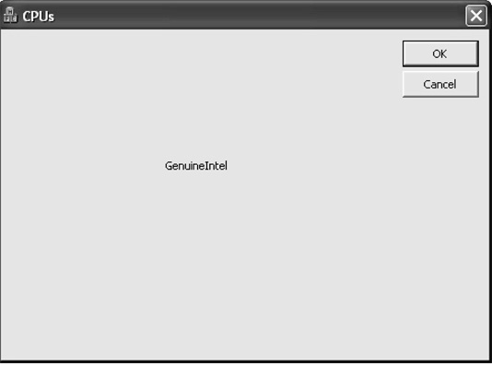
Figure 18–11 Screen shot of the program of Example 18–1 using the CPUID instruction.

Slide 44
18–5 INTRO TO THE PENTIUM PRO
Before a processor can be used in a system, the function of each pin must be understood.
This section details the operation of each pin, along with the external memory system and I/O structures of the Pentium Pro processor.
Figure 18–12 illustrates the pin-out of the Pentium Pro processor, packaged in an immense 387-pin PGA (pin grid array).

Slide 45
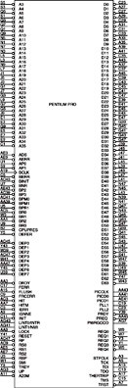
Figure 18–12 The pin-out of the Pentium Pro microprocessor.
Pentium Pro is available in two versions
one version with 256K level 2 cache
the other contains a 512K level 2 cache
the most notable difference in the pin-out of Pentium Pro is the provision for a 36-bit address bus
allows access to 64G bytes of memory

Slide 46
Pro requires a +3.3 V or +2.7 V power supply.
current maximum is 9.9 A at 150 MHz
maximum power dissipation of 26.7 W
A heat sink with good airflow is required.
Multiple V_{cc} and V_{ss} connections must all be connected for proper operation.
There are some pins labeled N/C (no connection) that must not be connected.
Each output pin is capable of providing an ample 48.0 mA of current at a logic 0 level.
Each input pin is a 15 µA current load.

Slide 47
Internal Structure of Pentium Pro
Pentium Pro is structured differently than earlier processors.
which contained an execution unit, and cached bus interface unit buffering the execution unit
Figure 18–13 shows a block diagram of the internal structure of the Pentium Pro processor.

Slide 48
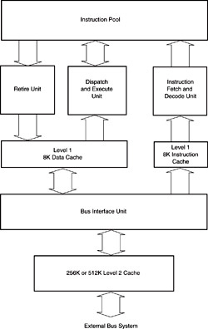
Figure 18–13 The internal structure of the Pentium Pro microprocessor.
system buses, which communicate to memory and I/O, connect to an internal level 2 cache
often on the main board in most other systems
level 2 cache in the Pro is either 256K or 512K bytes
integration of the level 2 cache speeds processing and reduces number of components in a system

Slide 49
The bus interface unit (BIU) controls access to system buses through the level 2 cache.
generates memory address and control signals, and passes/fetches data or instructions to an 8K level 1 data cache or a level 1 instruction cache
The instruction cache is connected to the instruction fetch and decode unit (IFDU).
separate instruction decoders decode three instructions simultaneously
outputs are passed to the instruction pool, where they remain until the dispatch and execution unit or retire unit obtains them

Slide 50
The dispatch and execute unit (DEU) retrieves instructions from the instruction pool when complete, and executes them.
DEU has three instruction execution units:
two for processing integer instructions
one for floating-point instructions
Reservation station (RS) schedules up to five events and can process four simultaneously.
Retire unit (RU) removes instructions that have been executed from the instruction pool.
three decoded instructions per clock pulse

Slide 51
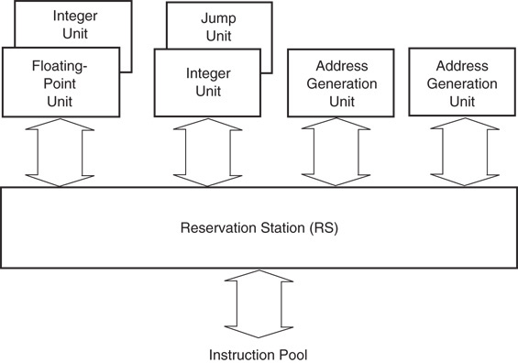
Figure 18–14 The Pentium Pro dispatch and execution unit (DEU).

Slide 52
The Memory System
The memory system for Pentium Pro is 4G bytes in size, just as in 80386DX–Pentium processors
2M paging is new to the Pentium Pro to allow memory above 4G to be accessed.
access between 4G and 64G is made possible by additional address signals A₃₂–A₃₅

Slide 53
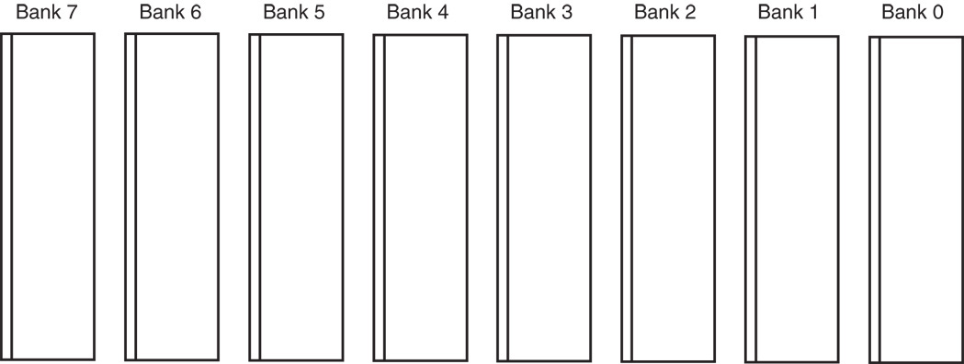
Figure 18–15 The eight memory banks in the Pentium Pro system. Note that each bank is 8 bits wide and 8G long if 36-bit addressing is enabled.
Pro uses a 64-bit data bus to address memory in eight banks that each contain 8G bytes of data.
additional memory is enabled with bit position 5 of CR₄ , accessible when 2M paging is enabled

Slide 54
Pentium Pro, like 80486 and Pentium, uses internal parity generation and checking logic for the memory system data bus information.
64-bit-wide memory is important to double-precision floating-point data
In the Pentium Pro processor, bank enable signals are presented on the address bus (A₁₅–A₈) during the second clock cycle of a memory or I/O access.
must be extracted from the address bus to access memory banks

Slide 55
Separate banks allow Pro to access any single byte, word, doubleword, or quadword with one memory transfer cycle.
Often eight separate write strobes for writing to the memory system.
Memory write information is provided on the request lines from the processor during the second clock phase of a memory or I/O access.
Pro is also able to check and generate parity for the address bus during certain operations.

Slide 56
New to Pro is a built-in error-correction circuit (ECC) allowing correction of a one-bit error and the detection of a two-bit error.
to detect/correct, memory must have room for an extra 8-bit number stored with each 64-bit number
The extra 8 bits store an error-correction code that allows Pro to correct any single-bit error.
A 1M × 64 is a 64M SDRAM without ECC, and a 1M × 72 is an SDRAM with EEC.
ECC code is far more reliable than the old parity scheme, now rarely used.

Slide 57
Input/Output System
The input/output system of Pentium Pr is completely compatible with earlier Intel processors.
I/O port number appears on address lines A₁₅–A₃ with the bank enable signals used to select the actual memory banks used for the I/O transfer.

Slide 58
System Timing
The basic Pentium Pro memory cycle consists of two sections.
the address phase and the data phase
During address phase, Pro sends the address (T₁) & control signals (T₂) to memory and I/O.
The control signals include the ATTR lines (A₃₁–A₂₄), DID lines (A₂₃–A₁₆), bank enable signals (A₁₅–A₈), and the EXF lines (A₇–A₃).
See Figure 18–16 for the basic timing cycle.

Slide 59
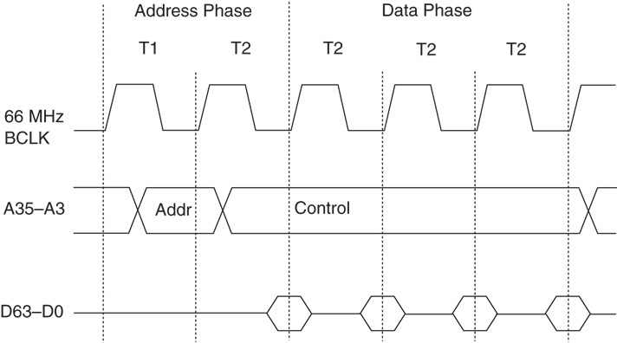
Figure 18–16 The basic Pentium Pro timing.

Slide 60
Cycle type appears on the request pins.
During the data phase, four 64-bit-wide numbers are fetched/written to the memory.
The 66 MHz Pentium Pro is capable of 33 million memory transfers per second.
assuming memory can operate at that speed
Setup time before the clock is given as 5.0 ns; hold time after the clock is given as 1.5 ns.
the data window around the clock is 6.5 ns
the address appears on the 8.0 ns maximum after the start of T₁

Slide 61
The Pentium Pro at 66 MHz allows 30 ns (two clocking periods), minus the address delay time of 8.0 ns and also minus the data setup time of 5.0 ns.
Memory access time without any wait states is 30 – 8.0 – 5.0, or 17.0 ns.
This is enough time to allow access to an SRAM, but not to any DRAM.
without inserting wait states into the timing

Slide 62
18–6 SPECIAL PENTIUM PRO FEATURES
The Pentium Pro is essentially the same processor as 80386, 80486, and Pentium, except that some additional features and changes to the control register set have occurred.
This section highlights the differences between 80386 control register structure and the Pentium Pro control register.

Slide 63

Figure 18–17 The new control register 4 (CR₄) in the Pentium Pro microprocessor.
Control Register 4
CR₄ has two new control bits added to the control register array
following is a description of the Pentium CR₄ bits and the new Pentium Pro control bits in control register CRM₄

Slide 64
Control Register 4 - Control Bits
VME - Virtual mode extension enables support for the virtual interrupt flag in protected mode.
if VME = 0, virtual interrupt support is disabled
PVI - Protected mode virtual interrupt enables support for the virtual interrupt flag in protected mode.
TSD - Time stamp disable controls the RDTSC instruction.

Slide 65
Control Register 4 - Control Bits
DE - Debugging extension enables I/O breakpoint debugging extensions when set.
PSE - Page size extension enables 4M-byte memory pages when set in the Pentium, or 2M-byte pages when set in the Pentium Pro whenever PSE is also set.
PAE - Page address extension enables address lines A₃₅–A₃₂ when a special new addressing mode, controlled by PGE, is enabled for the Pentium Pro.

Slide 66
Control Register 4 - Control Bits
MCE - Machine check enable enables the machine checking interrupt.
PGE - Page extension controls the new, larger 64G addressing mode when it is set along with PAE and PSE.

Slide 67
SUMMARY
The Pentium microprocessor is almost identical to the earlier 80386 and 80486 microprocessors.
The main difference is that the Pentium has been modified in-ternally to contain a dual cache (instruction and data) and a dual integer unit.
The Pentium also operates at a higher clock speed of 66 MHz.

Slide 68
SUMMARY
(cont.)
The 66 MHz Pentium requires 3.3 A of current, and the 60 MHz version requires 2.91 A.
The power supply must be a +5.0 V supply with a regulation of ±5%.
Newer versions of the Pentium require a 3.3 V or 2.7 V power supply.
The data bus on the Pentium is 64 bits wide and contains eight byte-wide memory banks selected with bank enable signals.

Slide 69
SUMMARY
(cont.)
Memory access time, without wait states, is only about 18 ns in the 66 MHz Pentium.
The superscalar structure of the Pentium contains three independent process-ing units: a floating-point processor and two integer processing units labeled U and V by Intel.
The cache structure of the Pentium is modified to include two caches.

Slide 70
SUMMARY
(cont.)
One 8K x 8 cache is designed as an instruction cache;
The other 8K x 8 cache is a data cache.
The data cache can be operated as either a write-through or a write-back cache.
A new mode of operation called the system memory-management (SMM) mode has been added to the Pentium.

Slide 71
SUMMARY
(cont.)
The SMM mode is accessed via the system memory-management interrupt applied to the SMI input pin.
In response to SMI the Pentium begins executing software at memory location 38000H.
New instructions include the CMPXCHG8B, RSM, RDMSR, WRMSR, and CPUID.

Slide 72
SUMMARY
(cont.)
The built-in self-test (BIST) allows the Pentium to be tested when power is first applied to the system.
A normal power-up reset activates the RESET input to the Pentium.
A BIST power-up reset activates INIT and then deactivates the RESET pin.
EAX is equal to a 00000000H in the BIST passes.

Slide 73
SUMMARY
(cont.)
A new proprietary Intel modification to the paging unit allows 4M-byte memory pages instead of the 4K-byte pages.
This is accomplished by using the page directory to address 1024 page tables that each contains 4M of memory.
The Pentium Pro is an enhanced version of the Pentium microprocessor that contains level 1 and level 2 caches of 256K or 512K found on most main boards.

Slide 74
SUMMARY
(cont.)
The Pentium Pro operates by using the same 66 MHz bus speed as the Pen-tium and the 80486.
It uses an internal clock generator to multiply the bus speed by various factors to obtain higher internal execution speeds.
The only significant software difference between the Pentium Pro and earlier microprocessors is the addition of the FCMOV and CMOV instructions.

Slide 75
SUMMARY
The only hardware difference between the Pentium Pro and earlier microprocessors is the addition of 2M paging and four extra address lines that allow ac-cess to a memory address space of 64G bytes.
Error correction code has been added to the Pentium Pro, which corrects any single-bit error and detects any two-bit error.

